Slide 1
Week 14 – Advanced Topics 2

Slide 2
Species as data points
Outline
The problem with species data
Phylogenetic signal in ecological traits
Why phylogeny matters in comparative study
Phylogenetically independent contrasts (PICs)
A linear model approach
A method for discrete data (and issues)

Slide 3
An example
Mating behaviors in 15 species of water striders (Gerris) (Rowe and Arnqvist 2002).
Biology: Males chase females, who flee by skating away. If a male grasps a female, she initiates a series of leaps, rolls, and summersaults that usually toss him off. Males of some species have clasping genitalia that allow them to stay on longer, but females of these species often have spines or other devices that make it difficult for males to grasp her. Mating takes place after a female stops struggling.
Variables to correlate are average duration of female struggles for each species, which are the periods of evasive action by females in response to lunges or grasps by males; and average mating frequency of females, measured under controlled lab conditions.

Slide 4
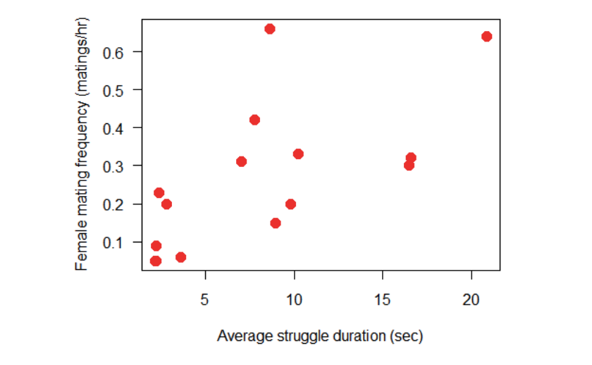
How are the variables related?
Data reveal a positive association between the two variables.
We would like to estimate the strength of the correlation.

Slide 5
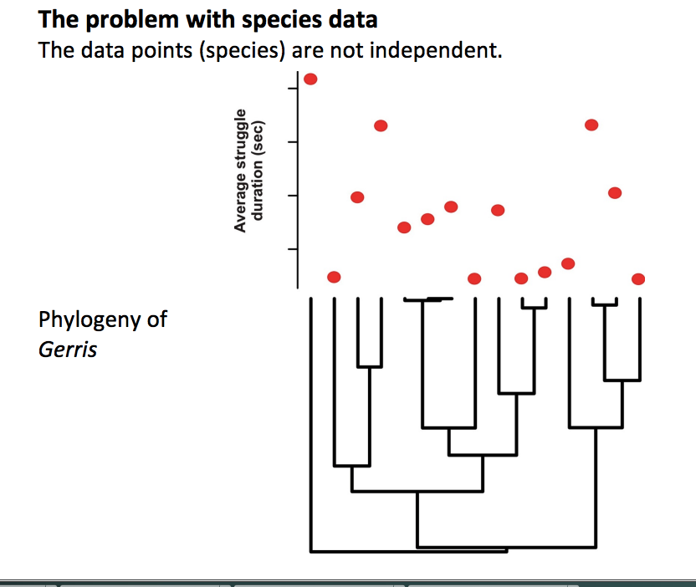

Slide 6
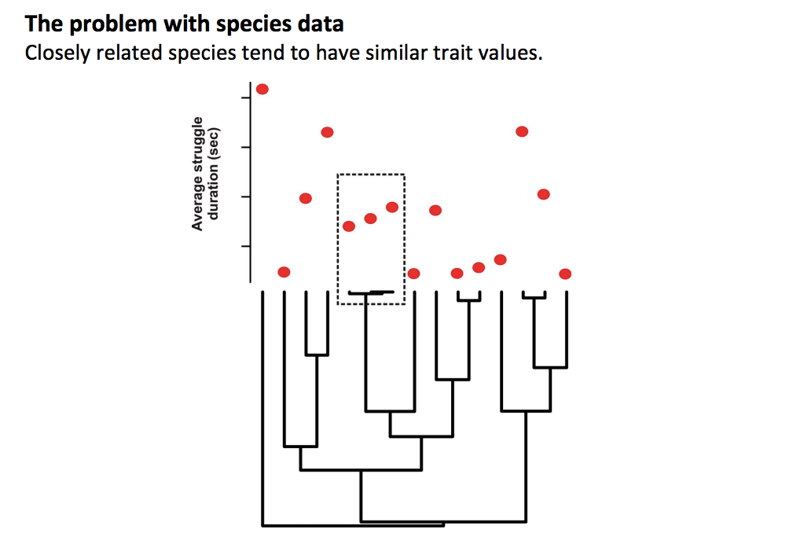
This is called phylogenetic signal

Slide 7
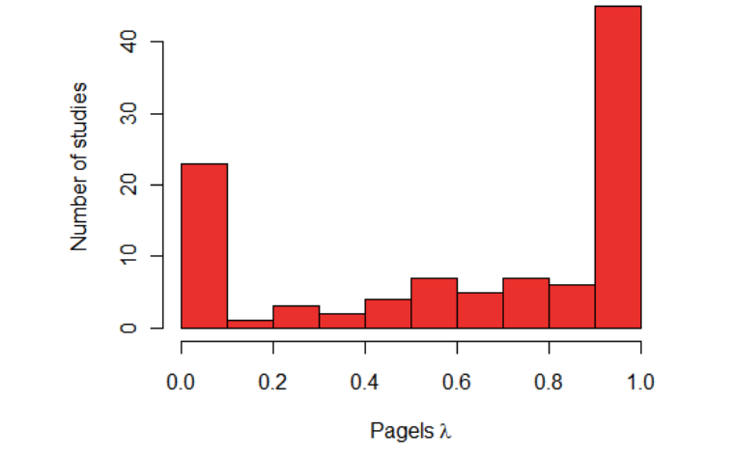
How prevalent is this problem?
Pagel’s λ measures the extent to which closely related species are similar in their trait values (phylogenetic signal). Here is a survey of λ-values from many studies and traits by Freckleton et al (2002):

Slide 8
Why is phylogenetic signal a problem?
We violate assumptions
We calculate our errors wrong
First highlighted by Joe Felsenstein - Felsenstein, J. (1985). "Phylogenies and the Comparative Method". The American Naturalist. 125: 1–2. doi:10.1086/284325.
EVERYONE should read this paper!!!

Slide 9
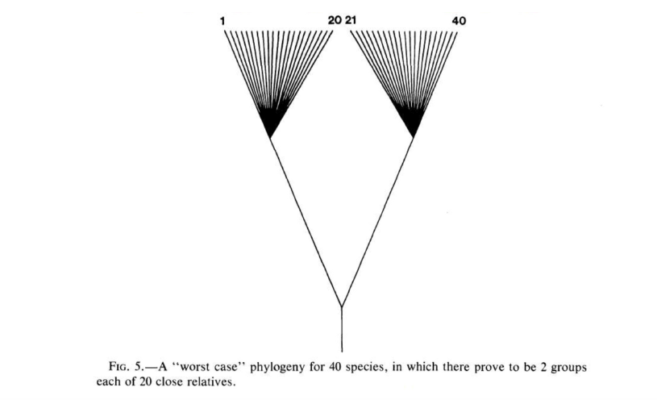
Worst case scenario phylogeny

Slide 10
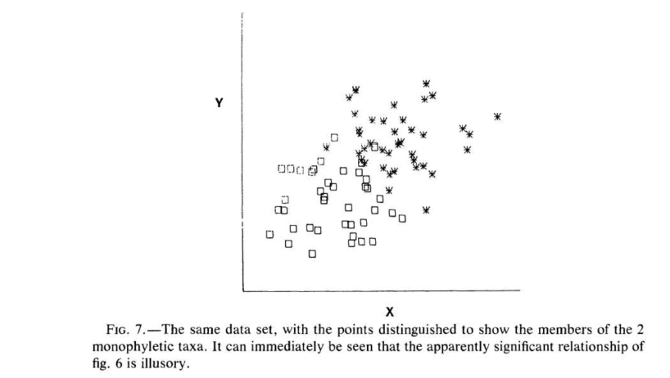
Ignoring phylogenetic signal

Slide 11
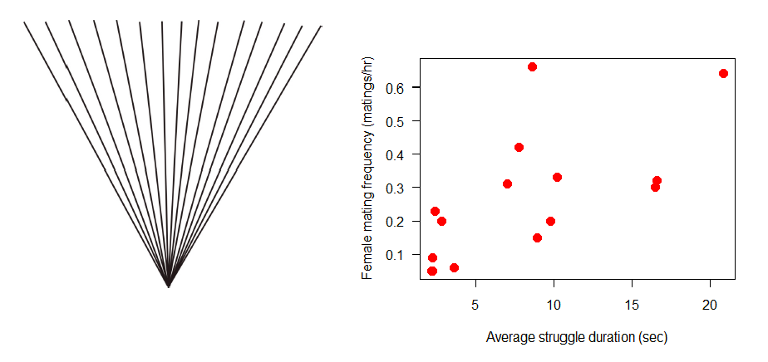
What we would actually be assuming about phylogeny when we ignore it

Slide 12
Felsenstein’s (1985) solution
Method assumes that the evolution of traits is mimicked by a continous random walk (Brownian motion)
Under Brownian motion, the difference between two species in a trait value has a normal probability distribution with a mean = 0, and a variance proportional to the time since their common ancestor

Slide 13
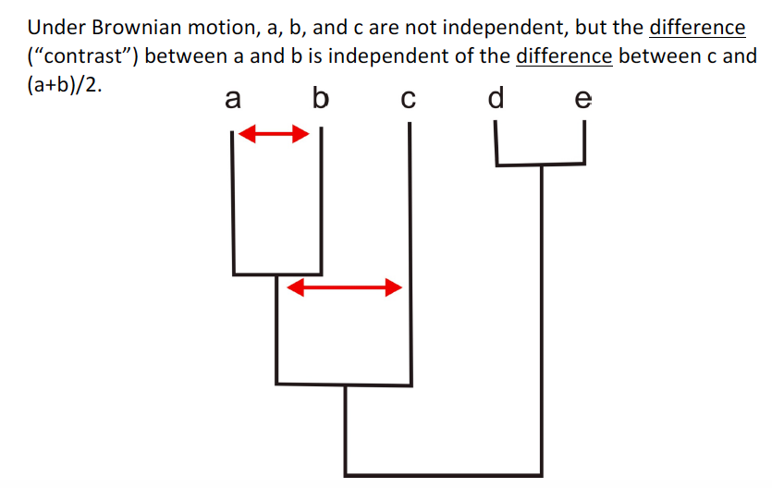
Felsenstein’s phylogenetically independent contrasts

Slide 14
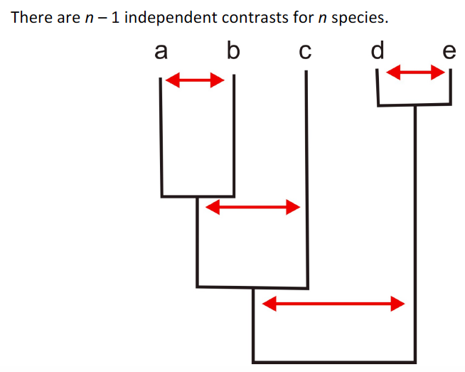
Felsenstein’s phylogenetically independent contrasts

Slide 15
Assumptions of PICs
Evolution in each trait mimics a continuous random walk in time (Brownian motion);
The rate of evolution is constant through time and along all branches of the phylogeny
Speciation and extinction are unrelated to trait values.
These seem difficult to verify.
If the assumptions are not met, then in extreme cases using independent contrasts might be worse than simply treating the species data as though they were independent (Harvey and Rambaut 2000).

Slide 16
Linear Model (GLS) approach
Mathematically equivalent to PICs
Gives access to all the suite of linear model tools
Incorporates correlation (e.g. phylogenetic signal) among trait values using a weighted matrix of expected covariance between data points

Slide 17
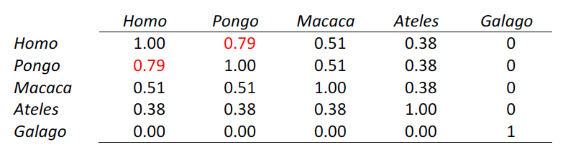
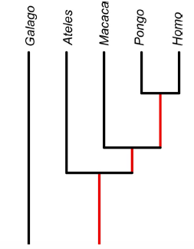
Specifying the covariance matric between data points

Slide 18
The result of including phylogeny
Data points from closely related species are down-weighted
Conversely, similar trait values between distantly related species can result in a stronger overall relationship

Slide 19
Resources
http://schmitzlab.info/pgls.html
https://lukejharmon.github.io/ilhabela/instruction/2015/07/03/PGLS/

Slide 20
Go to R…

